Slide 1
Server and Client Communication with RSA
PowerPoint Presentation in Information and Cybersecurity
By
Krishnaraj Thadesar, PA20, Batch A1

Slide 2
Contents
Introduction to Encryption on Client and Server - 3
Simple working of RSA - 4
Case study of how Whatsapp Encryption works - 7
Explanation of My Project - 12
Limitations - 13
Code and Outputs - 14

Slide 3
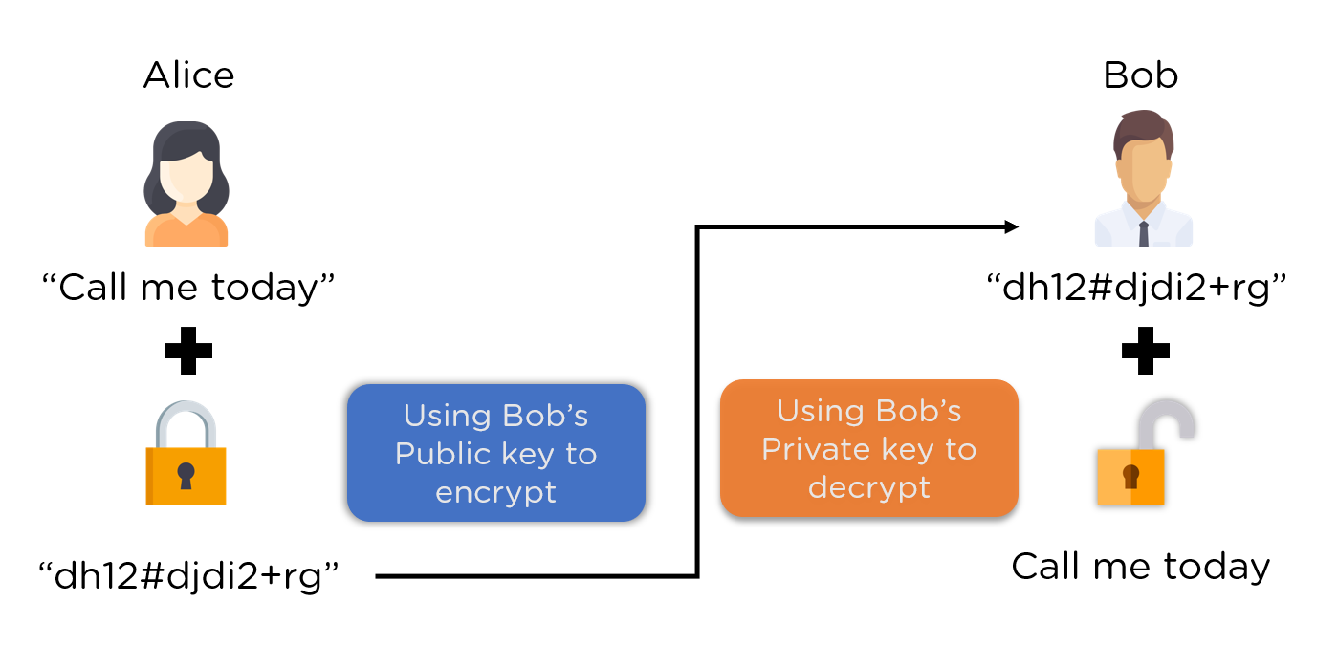
Basic Working of Encrypted Chats with Client and Server

Slide 4
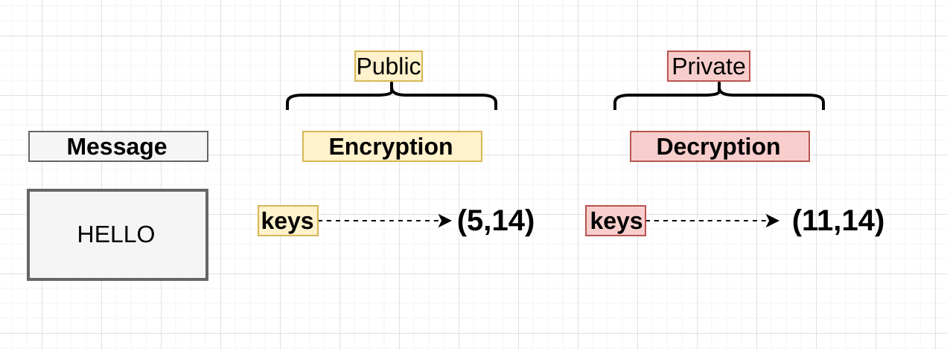
Simple Working of RSA

Slide 5
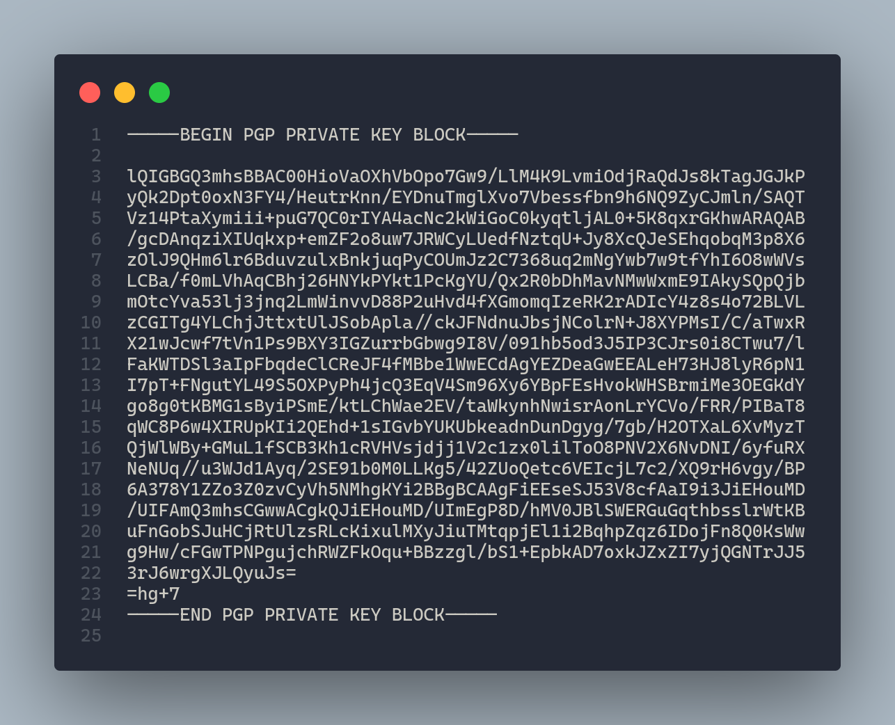
How the Keys looks like

Slide 6


Server Clients usually work with End to End Encryption
A good example of that is Signal, and Whatsapp, telegram etc.

Slide 7
WhatsApp’s E2E Encryption Protocol
WhatsApp uses open source Signal Protocol developed by Open Whisper Systems (They have their own messaging application, Signal). Signal Protocol uses primitives like Double Ratchet Algorithm, prekeys, Triple Diffie Hellman, Curve25519, AES and HMAC_SHA256.

Slide 8
What goes on in whatsapp - A simple case study
Session setup by Ankita using x3dh.
Ankita calculates master secret and Using DH Ratchet step, derives a root key and a chain key to be used by Hashing Ratchet.
Ankita derives a message key and next chain key using the chain key using Hashing Ratchet.
She encrypts her message using message key ( AES256 in CBC mode ).
Every time she sends a message her Hashing Ratchet moves forward.
Every time she receives a response from Bud, which includes a new public key in header, she advances her DH Ratchet, calculates a new root key and a new chain key.

Slide 9
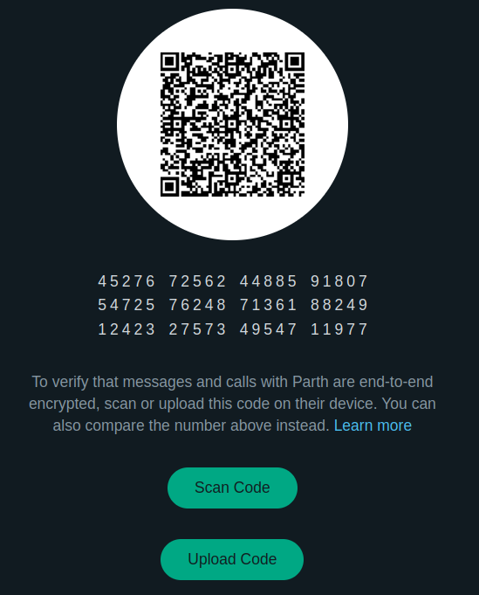

Slide 10
The QR code contains:
A version.
The user identifier for both parties.
The full 32-byte public Identity Key for all devices of both parties.

Slide 11
From Whatsapp Documentation
When either device scans the other’s QR code, the keys are compared to ensure that what is in the QR code matches the Identity Key as retrieved from the server. The 60-digit number is computed by concatenating the two 30-digit numeric fingerprints for each user’s device Identity Keys. To calculate a 30-digit numeric fingerprint:
Lexicographically sort public Identity Keys for all of the user’s devices and concatenate them.
Iteratively SHA-512 hash the sorted Identity Keys and user identifier 5200 times.
Take the first 30 bytes of the final hash output.
Split the 30-byte result into six 5-byte chunks.
Convert each 5-byte chunk into 5 digits by interpreting each 5-byte chunk as a big-endian unsigned integer and reducing it modulo 100000.
Concatenate the six groups of five digits into thirty digits.

Slide 12
Our Simple Setup
We have used RSA to encrypt and decrypt messages between the client and the server.
Their keys are shared using Diffie Hellman learnt and executed in a previous Assignment.
They communicate with TCP/IP protocol using the socket inbuilt library in python.
Communication is possible on any network, as long as host IP and port are known.

Slide 13
Our setup limitations
Only 1 client can talk to the server at one time. This can be improved by tweaking the code a little bit.
There is no means of reconnecting.
We can’t know if the server or client are both online or not once they go offline, so things like blue ticks and gray ticks would not work.

Slide 14
Code and Output

Slide 15

Transferring Video, or any media files is also possible this way.

Slide 16
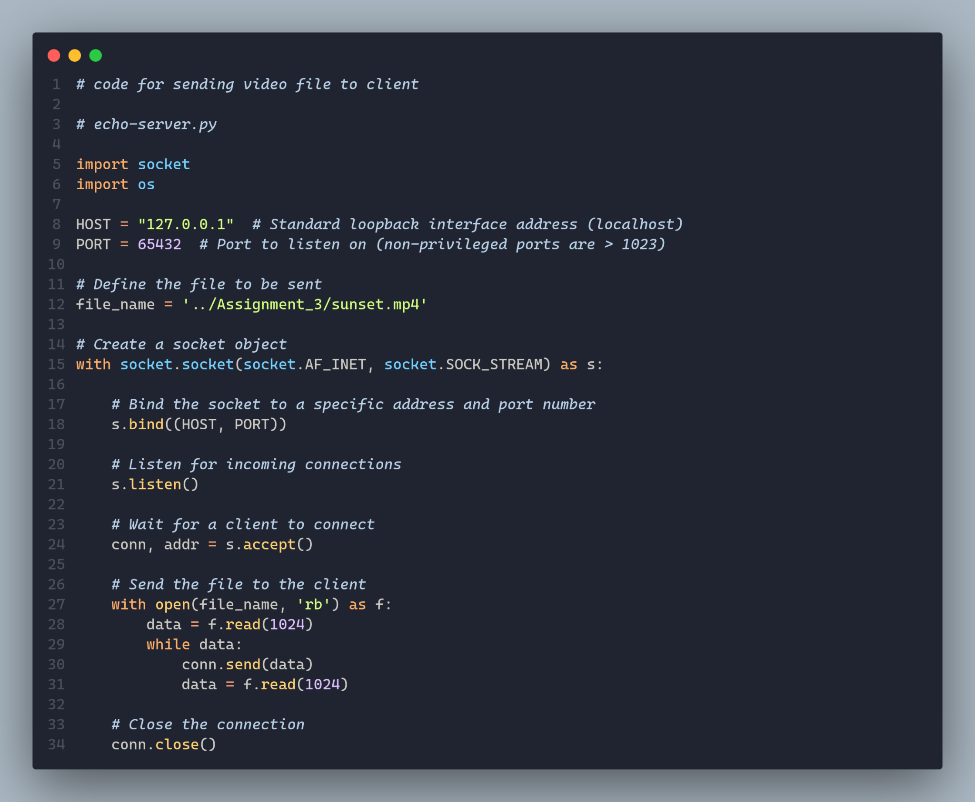

Slide 17
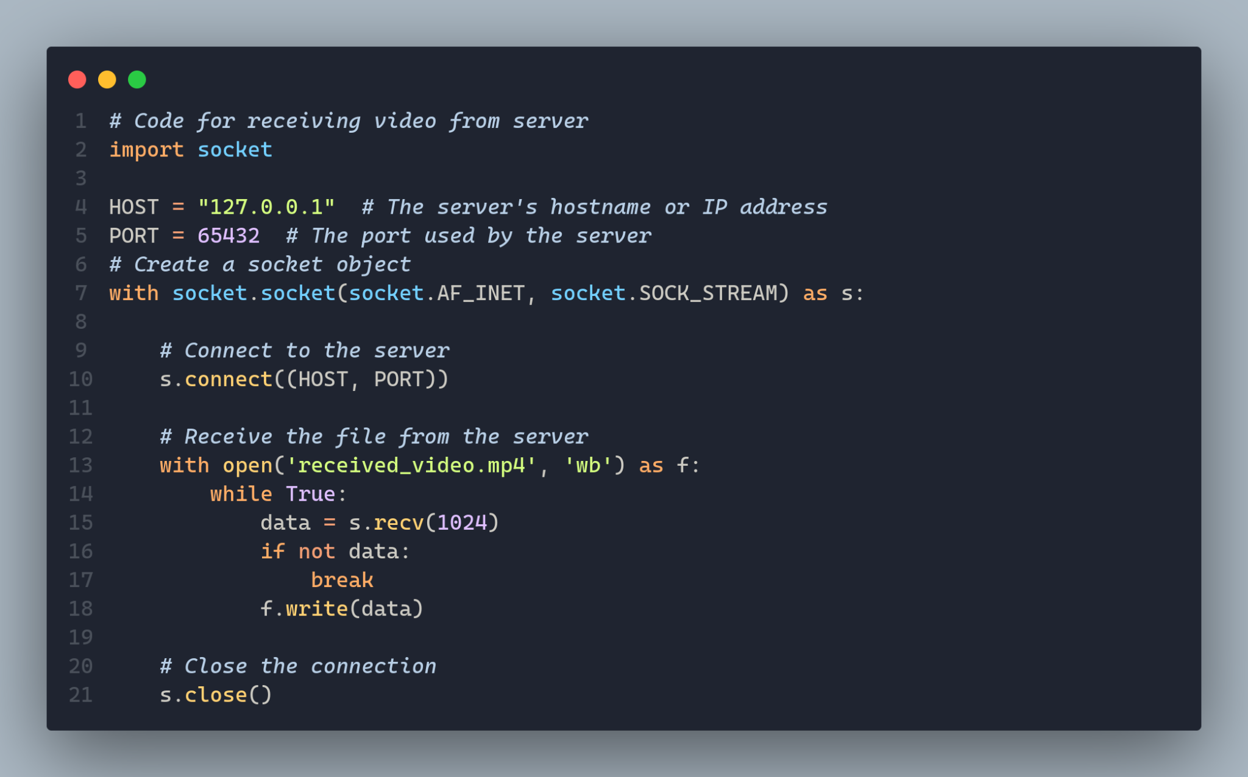

Slide 18
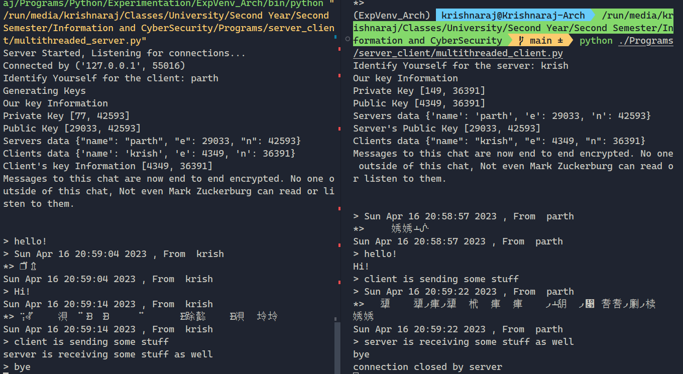

Slide 19
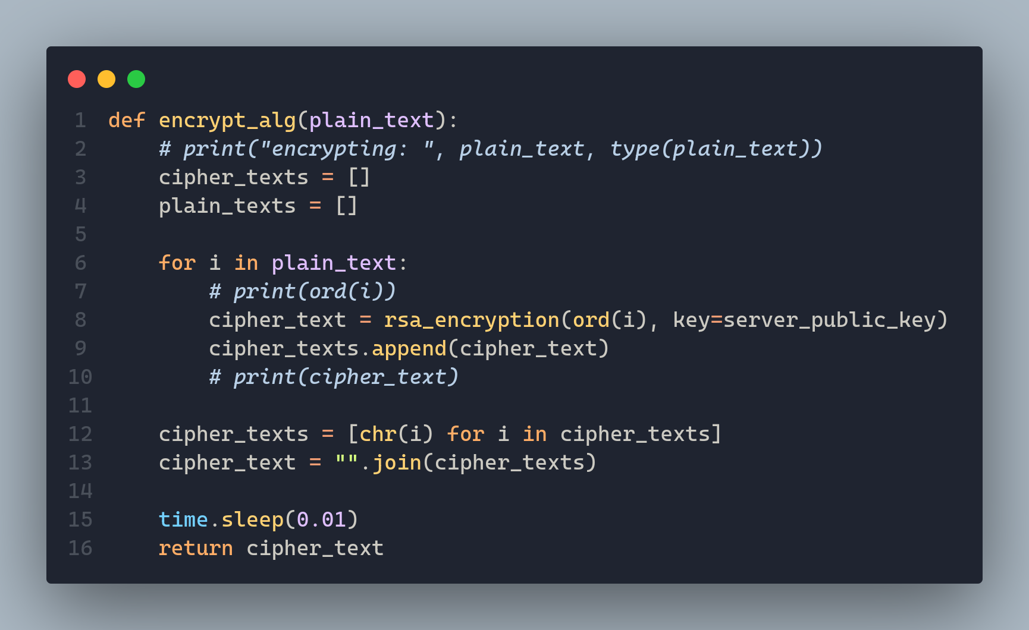

Slide 20
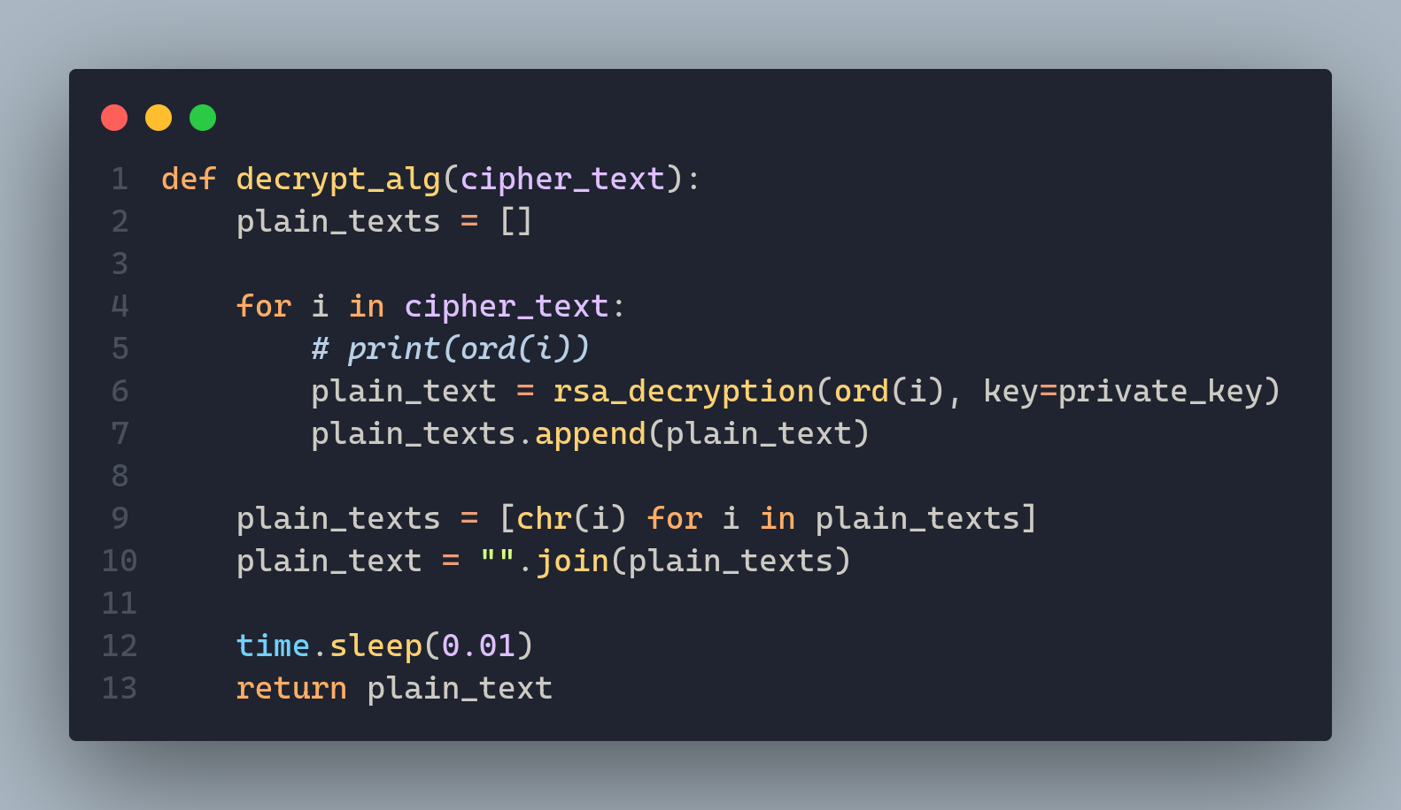

Slide 21
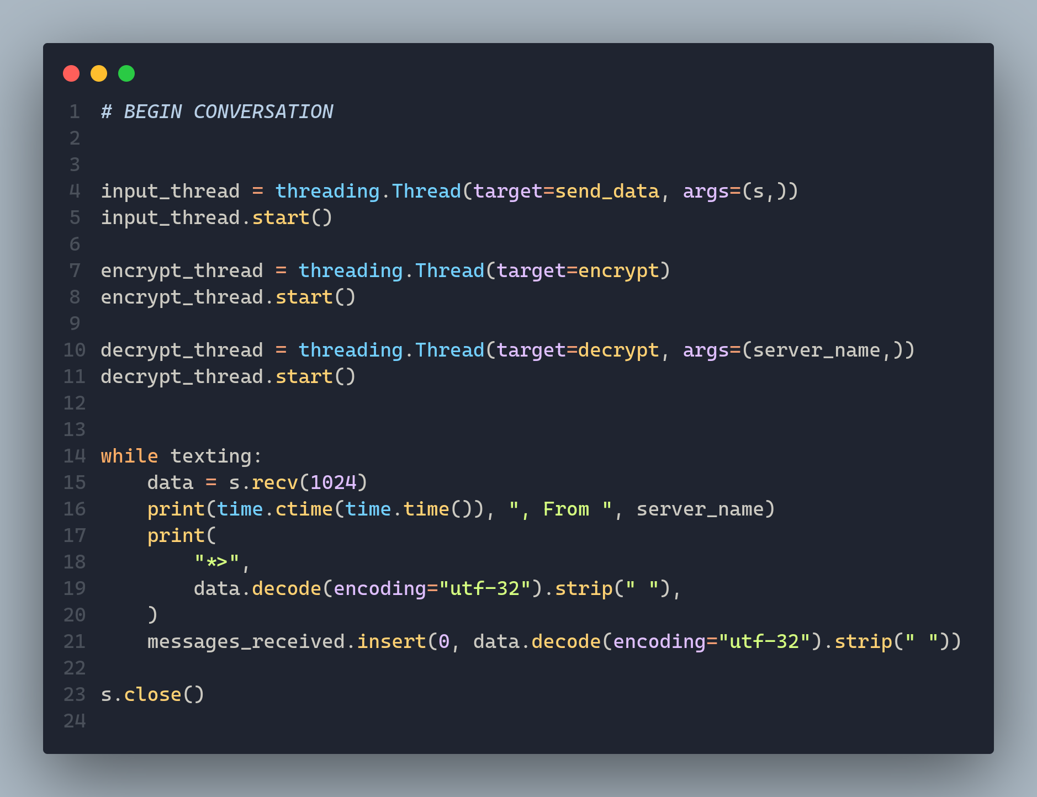

Slide 22
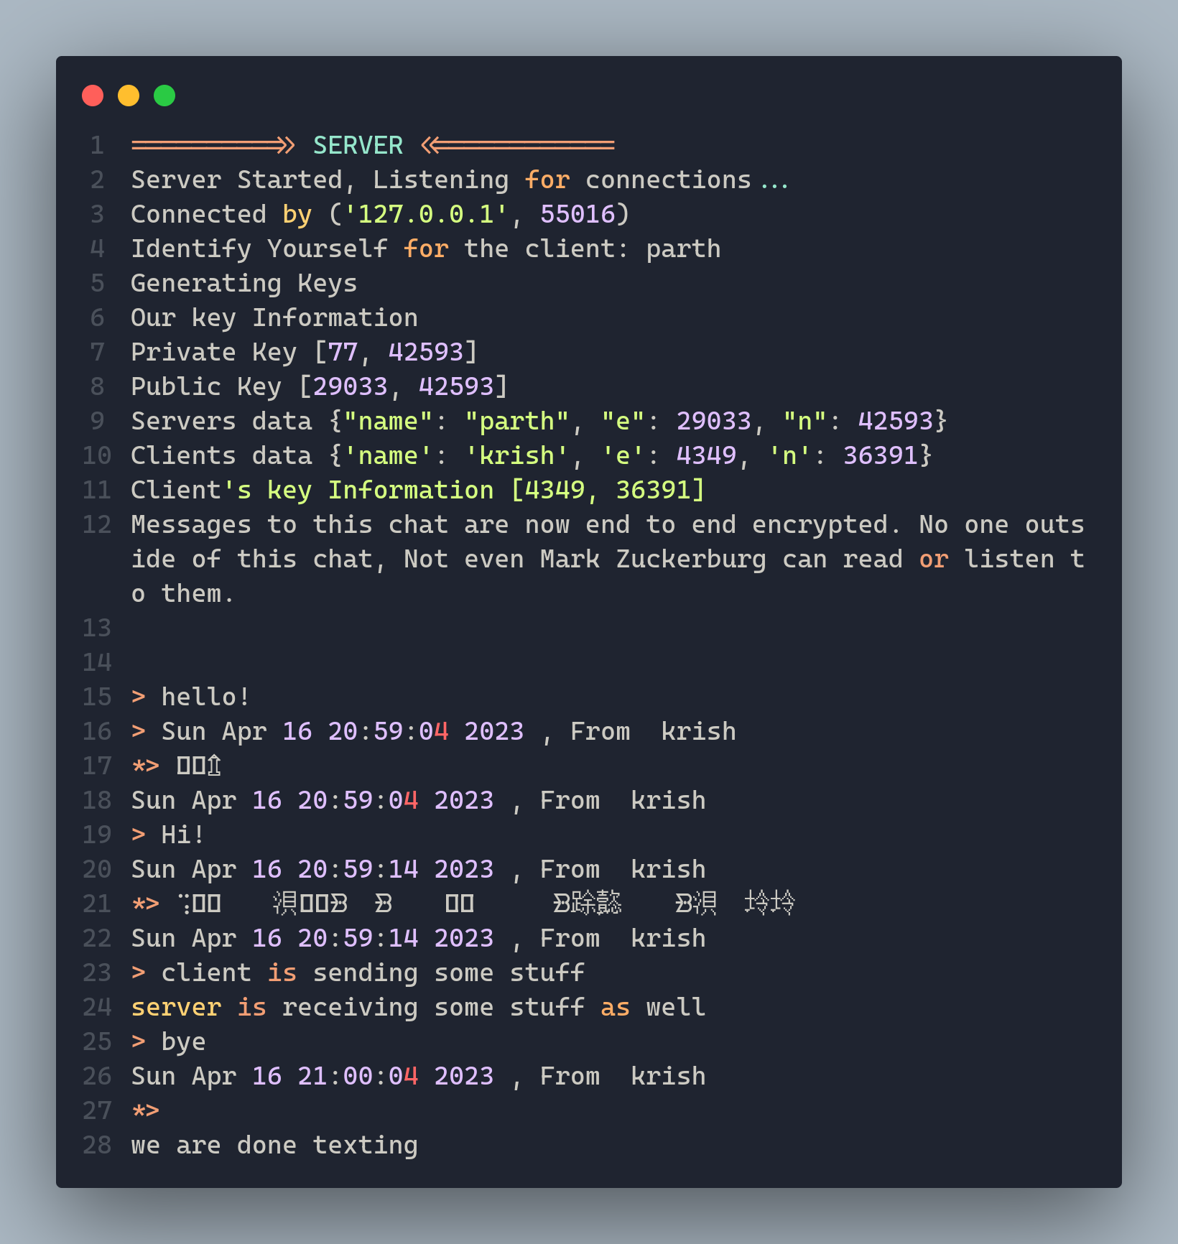
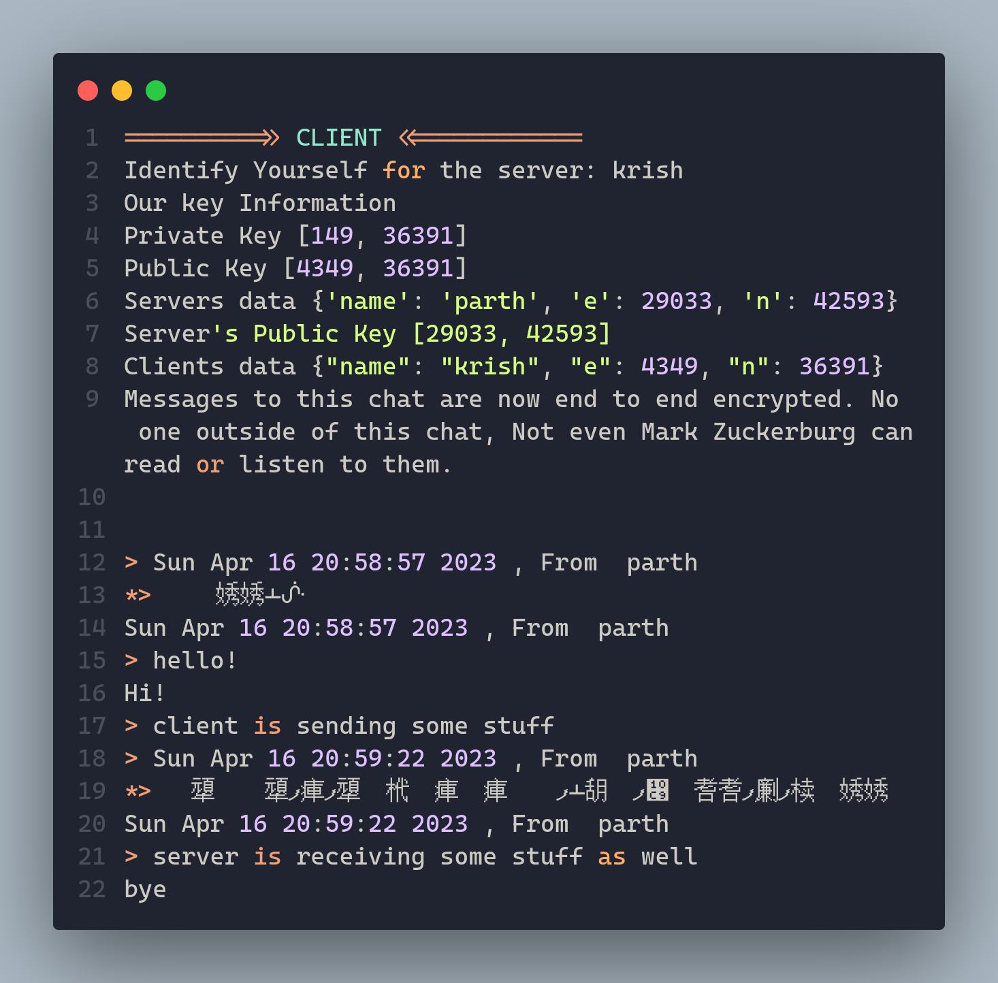

Slide 23
Thank You!

